Slide 1
NoSQL Whirlwind
Six Databases in Sixty Minutes

Slide 2
What is NoSQL?
Martin Fowler: Some characteristics are common amongst these databases, but none are definitional
Model not using the SQL language
Designed to run on large clusters
Not using the relational model
No schema enforced
Open source

Slide 3
NoSQL Database Families*
HBase
Cassandra
Hypertable
Key-value
Columnar
Redis
Riak
Memcached
MongoDB
CouchDB
RavenDB
Graph
Document
Neo4J
GiraffeDB
Infinite Graph
* “Seven Databases in Seven Weeks”, Eric Redmond and Jim R. Wilson

Slide 4
Typical.NET Stack vs. MEAN Stack
MVC
Express
C#
JavaScript (Node.js)
IIS
Apache
SQL Server
MongoDB
Rigidity

Slide 5
Products
Reviews
Store as strings
List of last 5 reviews

Slide 6

Ja Rule, Office Space, Gladiator, Zoolander, Night at the Roxbury, yukihiro matsumoto
I believe consistency and orthogonality are tools of design, not the primary goal in design. Yukihiro Matsumoto
Read more at http://www.brainyquote.com/quotes/authors/y/yukihiro_matsumoto.html#6XTioVg3r8TXrlDS.99
The orthogonal features, when combined, can explode into complexity. Yukihiro Matsumoto
Read more at

Slide 7
What is NoSQL?
Wikipedia: A broad class of database management systems identified by non-adherence to the widely used relational database management system model.
nosql-database.org: Next Generation Databases mostly addressing some of the points: being non-relational, distributed, open-source and horizontally scalable.
Martin Fowler: Some characteristics are common amongst these databases, but none are definitional.
Not using the relational model (nor the SQL language)
Open source
Designed to run on large clusters
Based on the needs of 21st century web properties
No schema, allowing fields to be added to any record without controls
Notes:
I’m a developer, like many of you so I like to try and spend as little time in the slides and as much time in the code as possible.
But there is some basic theory and core concepts we need to walk through in order to appreciate what you’re seeing code-wise.

Slide 8
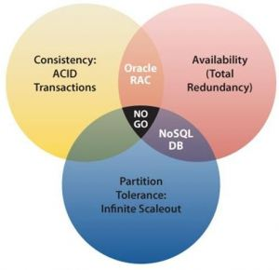
CAP Theorem
Consistency All nodes see the same data at the same time.
Availability A guarantee that every request receives a response about whether it was successful or failed.
Partition tolerance The system continues to operate despite arbitrary message loss or failure of part of the system.
Notes:
http://bigdatanerd.wordpress.com/2011/12/08/why-nosql-part-1-cap-theorem/

Slide 9
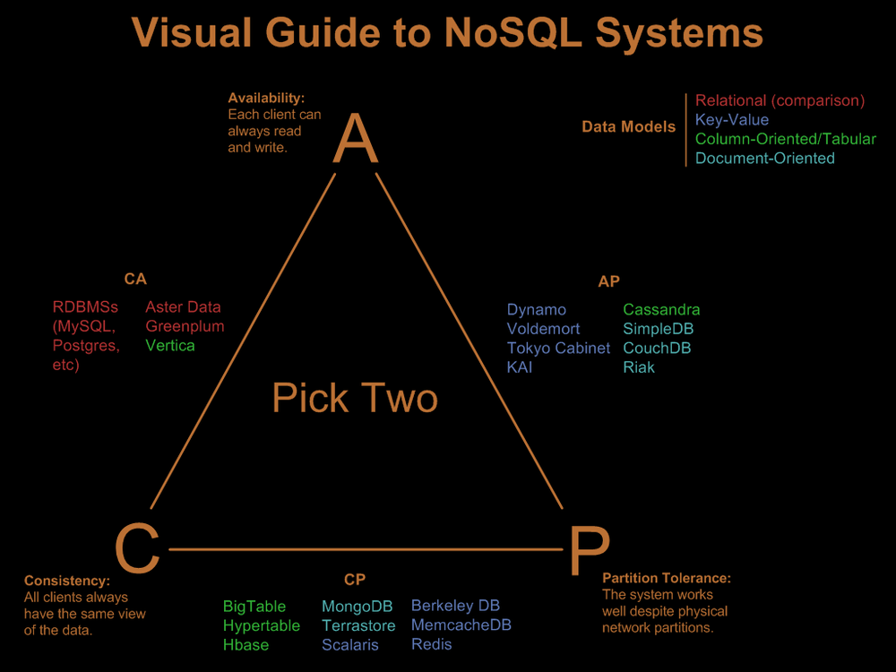
Notes:
http://blog.beany.co.kr/archives/275
Consistency means that each client always has the same view of the data.
Availability means that all clients can always read and write.
Partition tolerance means that the system works well across physical network partitions.
One of the primary goals of NoSQL systems is to bolster horizontal scalability. To scale horizontally, you need strong network partition tolerance which requires giving up either consistency or availability. NoSQL systems typically accomplish this by relaxing relational abilities and/or loosening transactional semantics.
Consistent, Available (CA) Systems have trouble with partitions and typically deal with it with replication.
Consistent, Partition-Tolerant (CP) Systems have trouble with availability while keeping data consistent across partitioned nodes.
Available, Partition-Tolerant (AP) Systems achieve “eventual consistency” through replication and verification.

Slide 10
All Databases
Relational Databases (Oracle, mySQL, Postgres, SQL Server)
NoSQL (MongoDB, Redis, Neo4J, Cassandra, Hbase)

Slide 11
Document databases*
Key/Value: A document database is, at its core, a key/value store with one major exception.
Format: The data will be stored in a format that the database can understand (XML, JSON, Binary JSON, etc.)
Schema Free: A document database is schema free, that is, you don’t have to define your schema ahead of time and adhere to that.
Relationships Not Enforced: It does not, however, support relations. Each document is standalone. There is nothing to enforce relational integrity.
Benefit: The major benefit of using a document database comes from the fact that while it has all the benefits of a key/value store, you aren’t limited to just querying by key.
* Excerpts from: http://ayende.com/blog/4459/that-no-sql-thing-document-databases
Notes:
Why is this such a big thing? Because when the database can understand the format of the data that you send it, it can now do server side operations on that data. In most doc dbs, that means that we can now allow queries on the document data.The known format also means that it is much easier to write tooling for the database, since it is possible to show, display and edit the data.
It also allow us to store arbitrarily complex data. If I want to store trees, or collections, or dictionaries, that is quite easy. In fact, it is so natural that you don’t really think about it.

Slide 12
Example of a schema-less data structure
Books/33
Id | Title | Author
33 | “War & Peace” | “Leo Tolstoy”
Books/417
Id | Title | Author | Price
417 | “Pro ASP.NET MVC 4” | “Adam Freeman” | 29.99
Books/5908
Id | Title | Price | Inventory | ISBN
5908 | “Amistad” | 7.18 | 100 | { “1936719002”, “978-1936719006” }

Slide 13
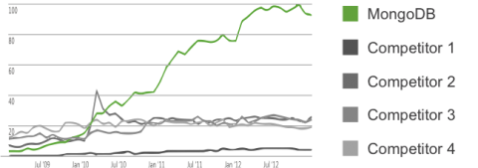
MongoDB Search Trends – Google

Slide 14
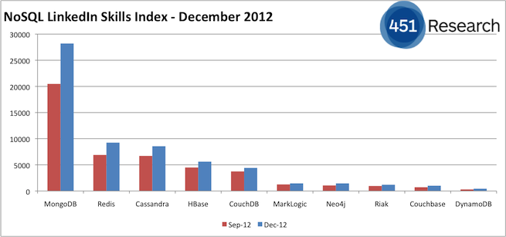
More Job Trends – LinkedIn

Slide 15
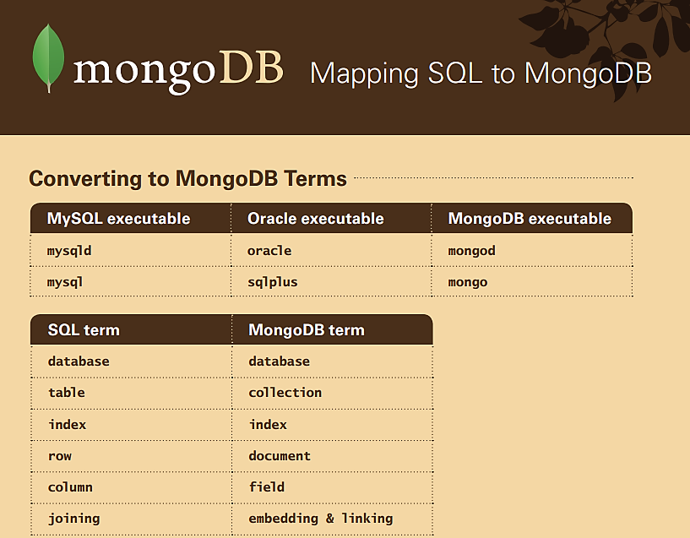
10gen Quick Reference Card

Slide 16
Example BSON Document
{
"_id" : ObjectId("5218282429f4a04648f64870"),
"Title": "What's new in MongoDB 2.4",
"Content" : "MongoDB 2.4 represents hundreds of improvements and features driven by user requests...",
"Author" : {
"FirstName" : "David",
"LastName" : "Green"
},
"CreatedOn" : ISODate("2013-07-19T01:30:52Z"),
"LastModifiedOn" : ISODate("2013-08-24T03:27:32Z"),
"Comments" : [],
"Tags" : [
"C#",
".NET",
"NoSQL",
"MongoDB"
]
}

Slide 17
When not to use MongoDB
When one or more of the following are insurmountable even after modelling:
Relationships/Join
Transactions
Write Safety

Slide 18
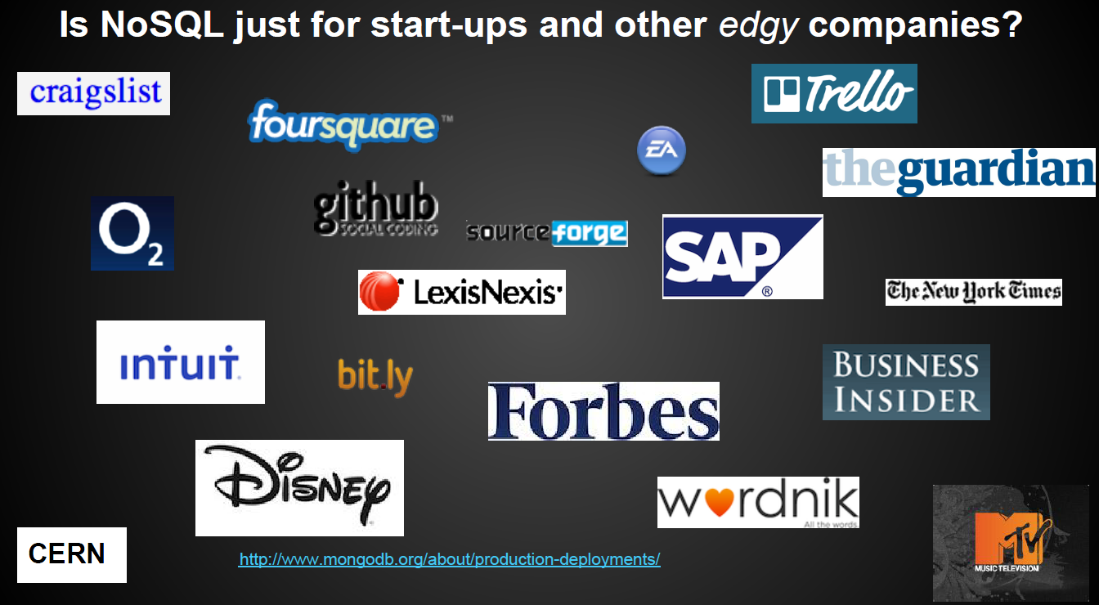

Slide 19
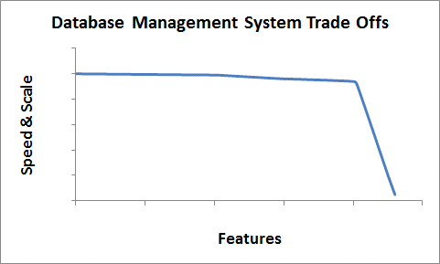
memCached
MongoDB
X
X
SQL Server
X

Slide 20
Some stuff about history part 2
noSQL history in one slide

Slide 21
Who is this guy?
David Green
Developer for 15 years in the MSFT stack (C#, VB.NET, MVC, SQL Server, etc.)
Speaker chair Monthly TriNUG Meetup
Organizer of TriNUG Data SIG Meetup
Contributor to http://justazure.com
My blog: http://nosqlguy.com
Aspiring PluralSight Author

Slide 22
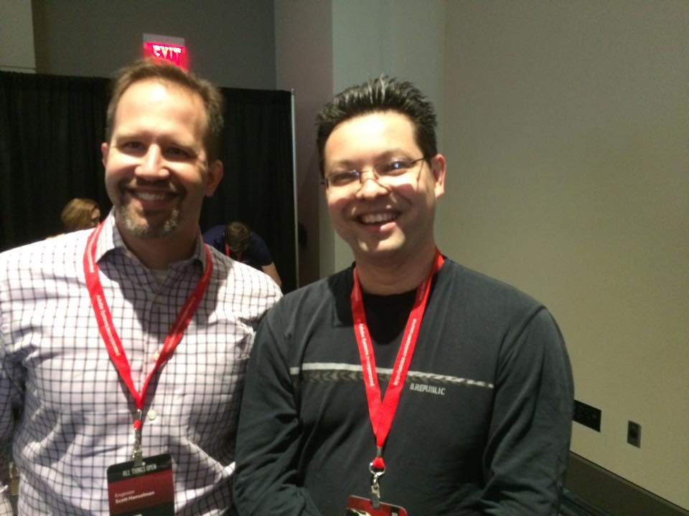

How did I get into this?
Tired of UI? Hate JS, WebForms, XAML, MVC, Angular, etc.
Read blog
Spent 2 months reading everything about RavenDB. Thought I could write a book and I wrote to Apress and they said yes. And then no, we think you should write a
book about MongoDB. I don’t know anything about MongoDB…yet. So I said give me a few months. Learned everything I could find for a few months…but ended up not writing a book.
???
Kruger-Dunning effect of
Thinking I could write a book.
But the process of learning something from nothing is what inspired this talk. This talk is about NoSQL databases. But it’s also about learning. How I learn things, maybe it’s of some help.

Slide 23
This is a talk mainly for developers, architects, or maybe just people who want to learn how to learn
Let’s take a step back and look at the profession of developers.
Many of you senior peoplealready know this stuff, but when I was starting out I didn’t and I think its good material for junior developers
Enterprise is typically (companies):
Brownfield developer
Single stack (somewhat rigid)
Typically Java or C# based stack
Other is typically (startup, indie):
Greenfield developer
Maybe more than one stack (less rigid)
Usually tend to be alternative or hipster stacks like Ruby or Node.js

Slide 24
Why do I care?
There is no such thing as a developer who does not understand databases at some level.
Things are changing.
That rigidity at the bottom of the stack is being tested…becoming more amorphous.

Slide 25

Ways to Learn/Hack NoSQL
Include pictures of lots of ppl because learning and growing as a
developer involves other people. Recognizing that you may be smart but you need a mentor (even if its virtual). Someone to inspire and keep you going

Slide 26
Amount of data/transaction
# Bytes per transaction | Total Time | Row Insert Time | Overhead | Bytes/sec
1 | 71ms | 0.3ms | ~70ms | 14 (0.14 KB/s)
100 | 80ms | 0.4ms | ~80ms | 1250 (1.22 KB/s)
10240 (10KB) | 90ms | 10ms | ~80ms | 113,777 (111.9KB/s)
5242880 (5MB) | 275ms | 175ms | ~100ms | 19,065,018 (18618.2 KB/s)
X500
X17.5

Slide 27
Acts like a single file database (.edb)
Supports transactions
Support for simple querying (Single/multiple column “WHERE” like clauses, simple aggregates)
Supports indexes.
C# - best to use Managed ESENT library (3rd part .dll)
An ESE database may contain up to 232 pages, or 16 terabytes of data, for 8 kilobyte sized pages.
The maximum size of a Long Text or Long Binary column value is 2 GB.

Slide 28
Client
Database Management System (DBMS)
Storage Engine

Slide 29

Eloquera
Learning principle: quote from James Altucher about history
If you don’t love the history of what want to master, then you will never master it. I don’t think I know a single chess master who hasn’t read through Bronstein’s “1953 Zurich International” tournament book at least a dozen times. Or Mikhail Tal’s “Best games”. Poker players have read Doyle Brunson’s classic a dozen times. And entrepreneurs have all now read Walter Isaacson’s book on Steve Jobs and dozens of other biographies of successful businessmen. The history of a game or life is your virtual mentor if you don’t have a direct mentor.

Slide 30
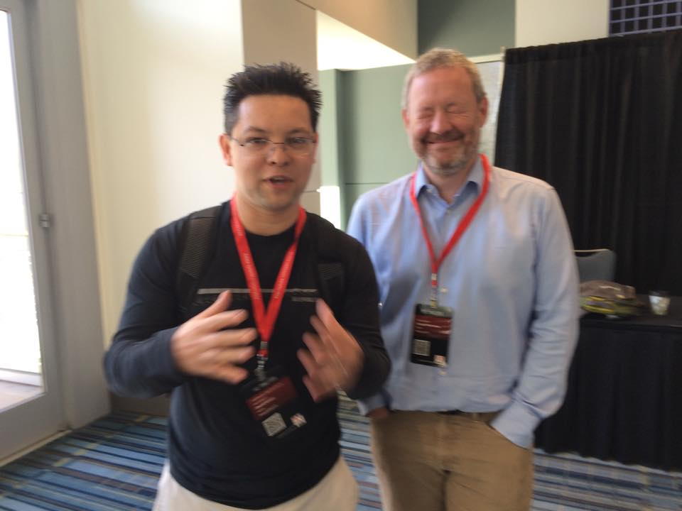
“They see me rollin They hatin Patrolling they tryin to catch me ridin’ writing dirty Tryin to catch me ridin’ writing dirty Tryin to catch me ridin’ writing dirty”
- Chamillionaire

Slide 33
Database Management System
Memory (RAM)
2
Client
1
4
3
Hard Drive

Slide 34
Database Management System
Memory (RAM)
B
Client
A
C
B
Hard Drive

Slide 35
Canonical (Simple)Columnar Example
Relational Modeling
Id | Name | City | Income
1 | Jeff | Durham | 70,000
2 | Mary | Raleigh | 25,000
3 | Peter | Raleigh | 110,000
4 | Sanjay | Durham | 150,000
5 | Beth | Cary | 213,000
Columnar Modeling
Durham | [70,000, 1500,000]
Raleigh | [25,000, 11000,000]
Cary | [213,000]

Slide 36
Data Size
Key-Value
You are here
Columnar
Document
Graph
Data Complexity

Slide 37
_{COLUMNAR DATABASES}
Useful in Big Data scenarios
There is no point to running this as a single node…you want to run this a as distributed set of nodes on commodity hardware to get any real benefit from wide column
Memory considerations (working set) - Canonical example of computing average salary of users:
Show schema in RDMS/document
Show schema in Wide Column
Tend to be Eventually consistent

Slide 38
Schema for Casandra Demo
USERS username (text) password (text)
FOLLOWED username (text) following (set {text})
FOLLOWING username (text) followed (set {text})
POSTS post_id (uuid) username (text)
post_date (timestamp) body (text)
USERPOSTS username (text) post_id (uuid) body (text)
Show all users
Show who a user is following
Show all posts Show all posts of a specific user

Slide 39
Things specific to Cassandra
Optimizes on fast and durable writes.
Underlying data structure: Bloom Filter
There a local mode for Windows (community edition). And its free.
Has CQL which is like SQL (not all wide column are this nice!)

Slide 40
Cassandra Overview
Open source distributed database management system for handling huge amounts of data across many commodity systems
Cassandra is a “NoSQL” or “Non-Relational” database and can be described as a mix between a “Key-value Store” and a “Column-Orientated” database

Slide 41
Where Did Cassandra Come From?
Cassandra was initially created at Facebook
Combination of Google Big Table and Amazon Dynamo
It was created to power the “Inbox Search” feature
Cassandra was released as open source in July of 2008
It became an Apache Incubator project in February of 2009 and It became a full level project a year after that

Slide 42
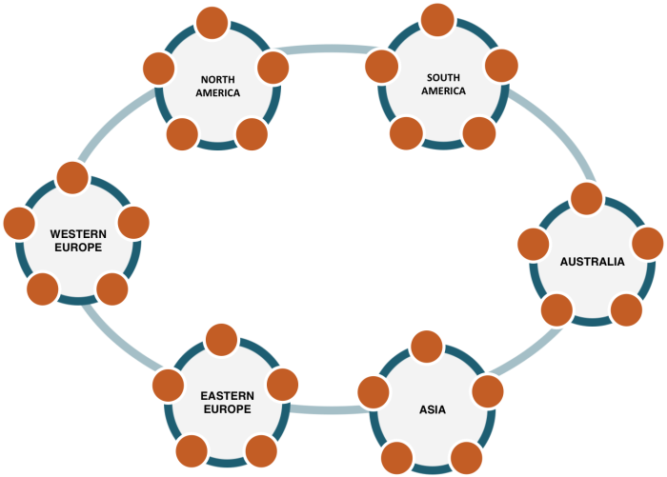
Cassandra Architecture
Built with the understanding that hardware & software failures can happen
Peer to Peer Architecture
All nodes are the same
Read/Write Anywhere
Gossip Protocol
Commit Log Captures All Activity
Well suited for cloud deployments

Slide 43
Features of Cassandra
Decentralized – No master & no single point of failure. Data is distributed across the cluster
Replication – Tailored for multiple-data center deployment
Scalability – New machines can easily be added with no downtime or interruption
Fault Tolerance – Failed nodes can be replaced with no downtime
Cassandra Query Language (CQL) – An SQL-like alternative

Slide 44
CQL (Cassandra Query Language)
CQL is very similar to SQL (Structured Query Language) in terms of syntax and commands
Statements directly change data and/or change the way data is stored
All statements end with a semi-colon
SELECT * FROM sampletable;

Slide 45
The Checklist
What category does this belong in? (Relational, Key-Value, Document, Graph, Columnar, Hybrid, Other)
What does this optimize on (i.e. do very well)? Reads, writes, transactions?
Is there a REST API? An SDK? Some native querying language?
Is the data format human readable: XML, JSON, etc.
Can it run on Windows? Linux? PAAS (Azure)?
Where does it fall on the CAP spectrum?
Auto-create database? Auto-create collections?
Is there a local mode?
Type of Indexing (Hash, B-tree, something else)
Does it support full-text search?
How does it scale? Support sharding?
How does it replicate? Master-slave or peer-peer?
Open Source?
Cost? If cloud based, how is this billed?
What kind of tooling is available? GUI based?
What are my options for technical support?

Slide 46
Programmability in DocumentDB
Familiar
Sandboxed
Transactional

Slide 47
Tunable Consistency in DocumentDB
Strong
Bounded Staleness
Session (Default)
Eventual

Slide 48
Eventual Consistency
R1
R2
R3
R4
R5
DocumentDB API
Response
Request
Client

Slide 49
Session (Default)
R1
R2
R3
R4
R5
DocumentDB API
Response
Request
Client

Slide 50
Bounded Staleness
R1
R2
R3
R4
R5
DocumentDB API
Response
Request
Client

Slide 51
Strong
R1
R2
R3
R4
R5
DocumentDB API
Response
Request
Client

